Slide 1




1
Power BI
Manager Guide
Prepared By :
Said Fawzy
Manager of Information Center
Tendering Department
Arab Contractors

Slide 2

Chapter 1: Introduction to Power BI

Slide 3
01
What is Power BI
02
Power BI History
Module Contents
What can you Expect from this course
03
What do you need for this course
04

Slide 4
05
Power BI Architecture
06
Walkthrough Journey of Power BI
Module Contents
Power BI Licenses
07
Download Power BI
08

Slide 5

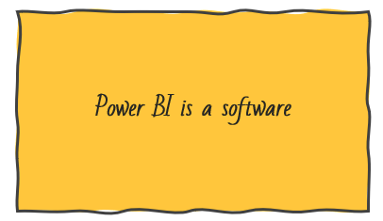




What is Power BI
Data Driven Decision Making

Slide 6


How is Power BI different from Excel?
Power BI allows rich, immersive and interactive experiences
Power BI works with large data sets.
Share and read reports easily.
Power BI is for story telling

Slide 7
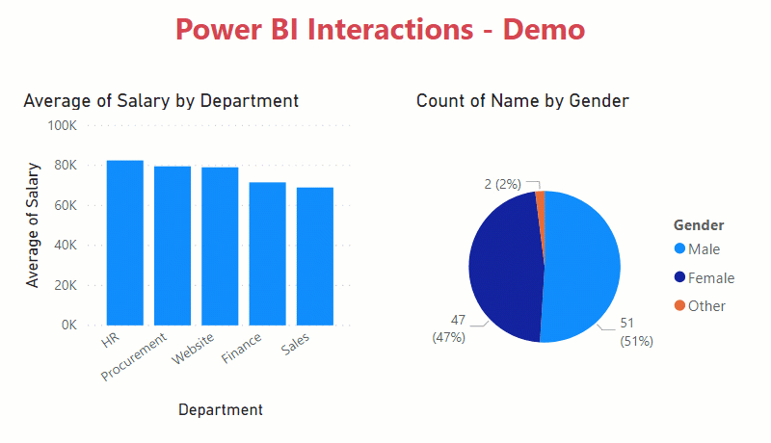
How is Power BI different from Excel?
Preparing Data for Analysis in Power BI

Slide 8
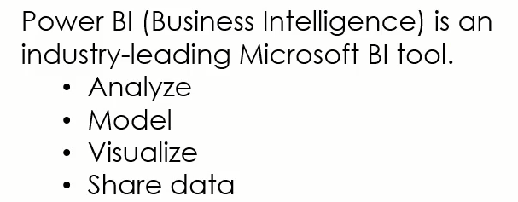
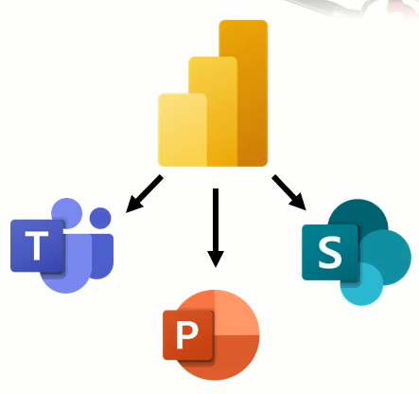
What is Power BI
Integration

Slide 9
What is Power BI
Purpose of Power BI
The ultimate purpose of Power BI is to put the power of data-driven decision-making into the hands of businesspeople in companies of any size anywhere.

Slide 10
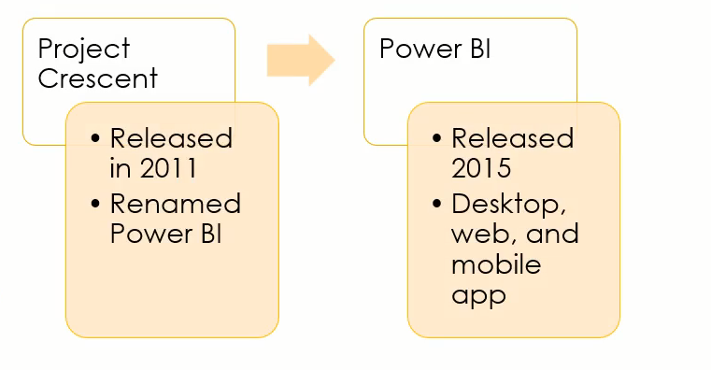
Power BI History

Slide 11

What you can expect from this course
Purpose of Using Power BI in Business.
How Power BI Professionals can give a final report publish.
Getting and Cleaning Data.
Create Data Model.
Use DAX Language.
Create Report in Power BI Desktop.
Publish and share report on Power BI Service.
Create Dashboard.
Create a Mobile Report.

Slide 12
What you can expect from this course
What reports can you get from Power BI.
Type of Charts Power BI can give and purpose of each one.
How to Use Power BI in Project Management.

Slide 13

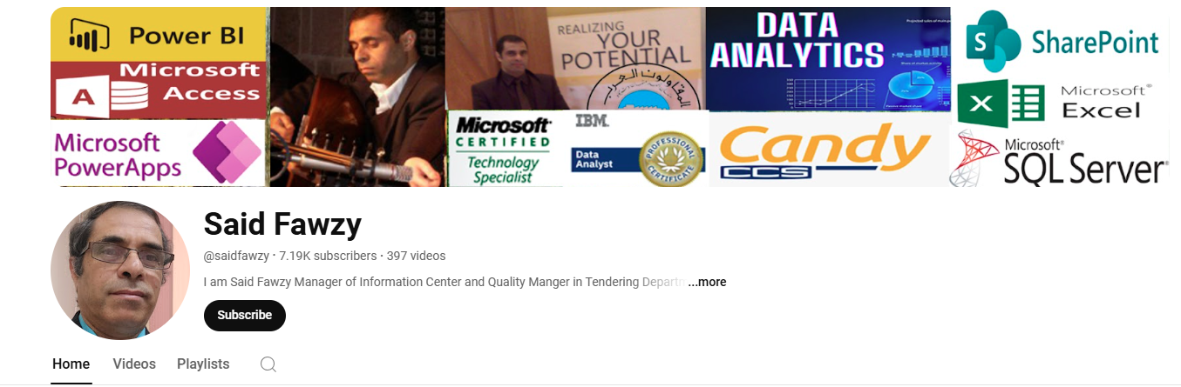
What you can expect from this course
You will receive your instructions in the form of practical example step by step.
You can also follow the Other Training course on my Channel on YouTube:
www.youtube.com/saidfawzy

Slide 14
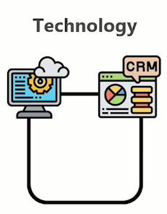

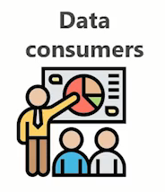
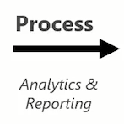
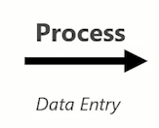
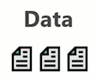

Data Life Sycle

Slide 15
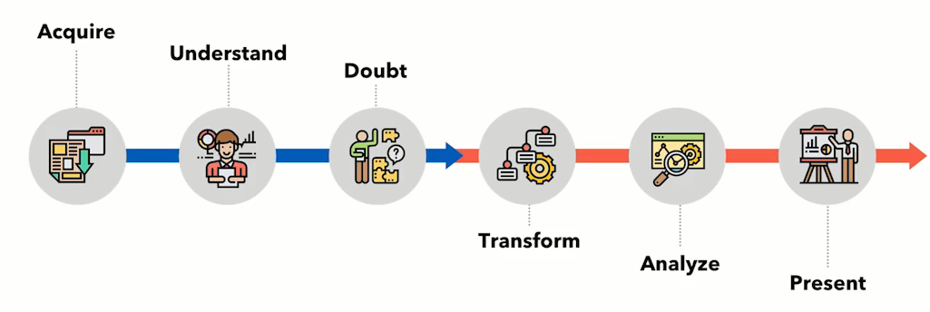

Analytics Process Flow

Slide 16
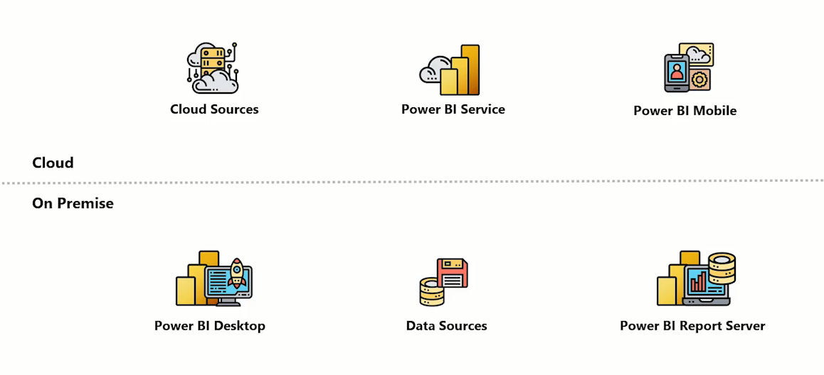
Power BI Architecture
Publish
Gateway

Slide 17
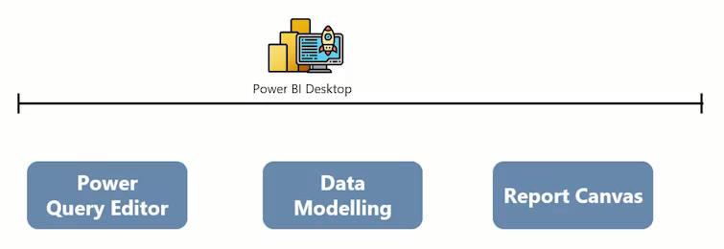
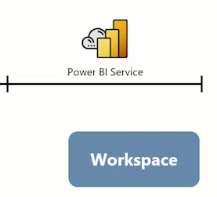
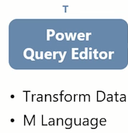

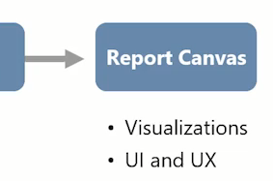

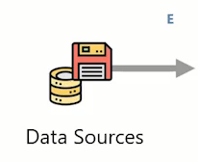

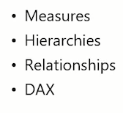
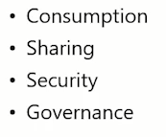
Power BI End to End Process Flow

Slide 18
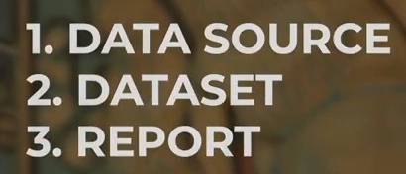
Business Intelligent Solution
Generally, they have those components:

Slide 19
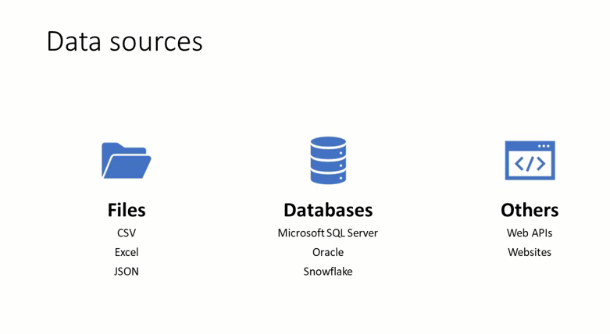
Business Intelligent Solution

Slide 20
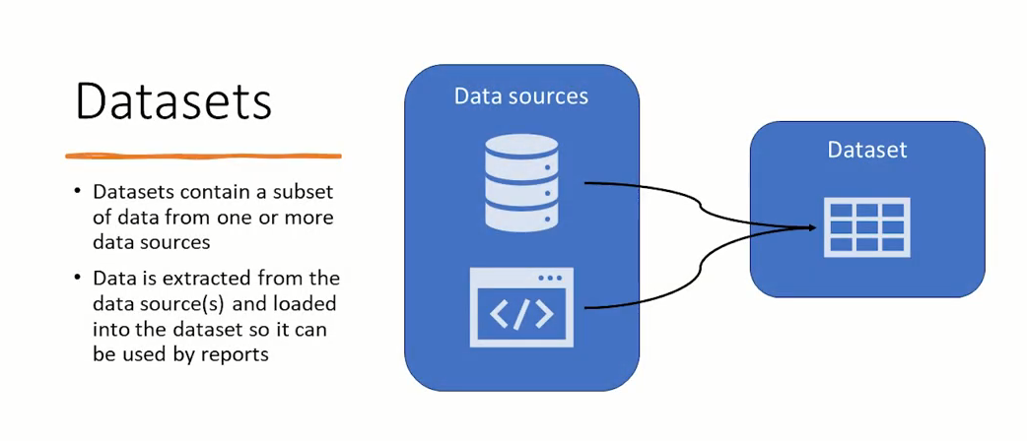
Business Intelligent Solution

Slide 21
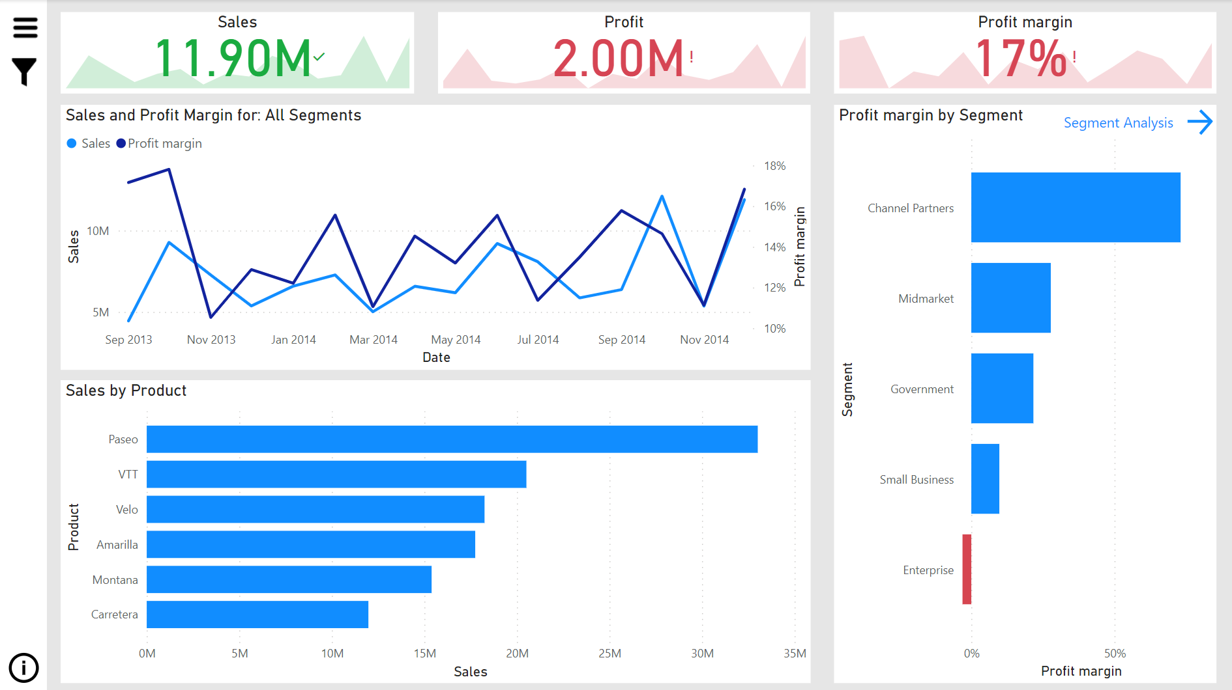
Business Intelligent Solution
Report

Slide 22
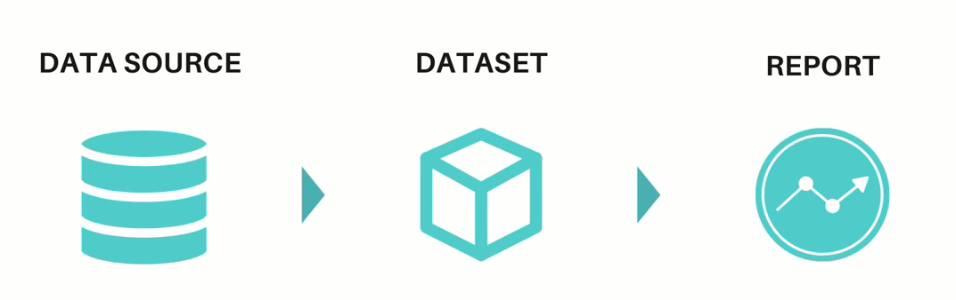
Business Intelligent Solution

Slide 23
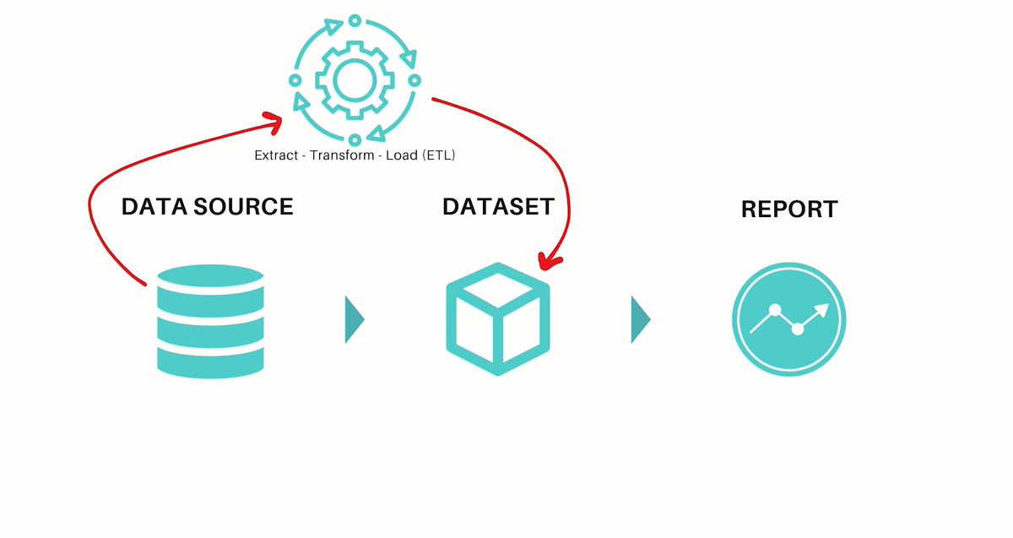
Business Intelligent Solution
Dataset can consist of one table or more

Slide 24
Business Intelligent Solution

Slide 25
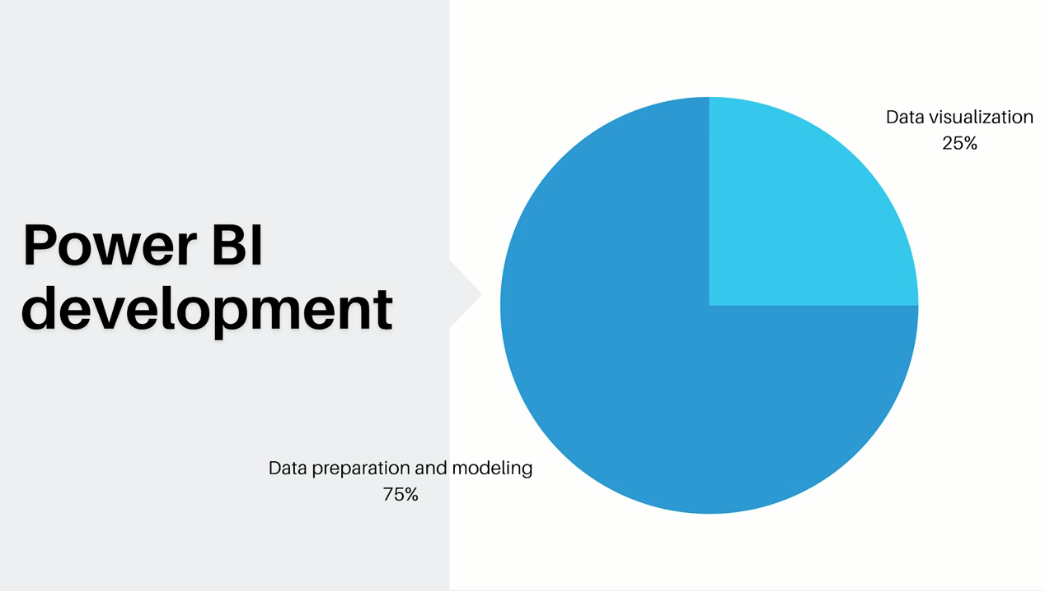

Slide 26

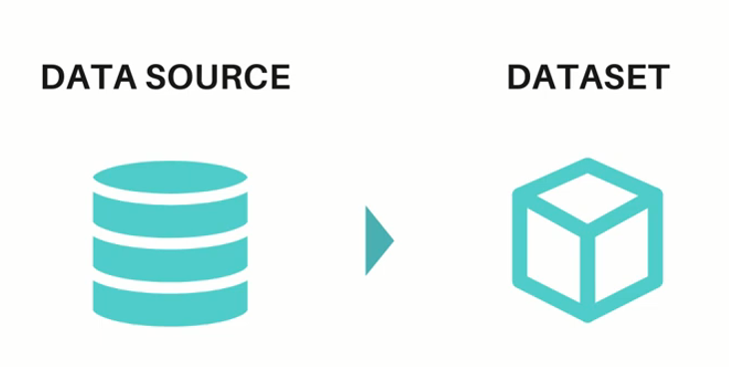
Analogy: Bake a cake and Make a Report
To bake a cake, you Fridge and Pantry your Source (Data source)
You only get what you need (Eggs , Flour ) (Dataset)

Slide 27

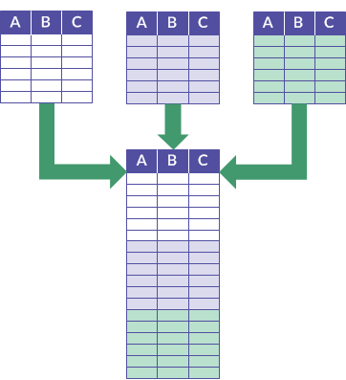

Analogy: Bake a cake and Make a Report
We want to transform our gradient
Combine and transform our data

Slide 28

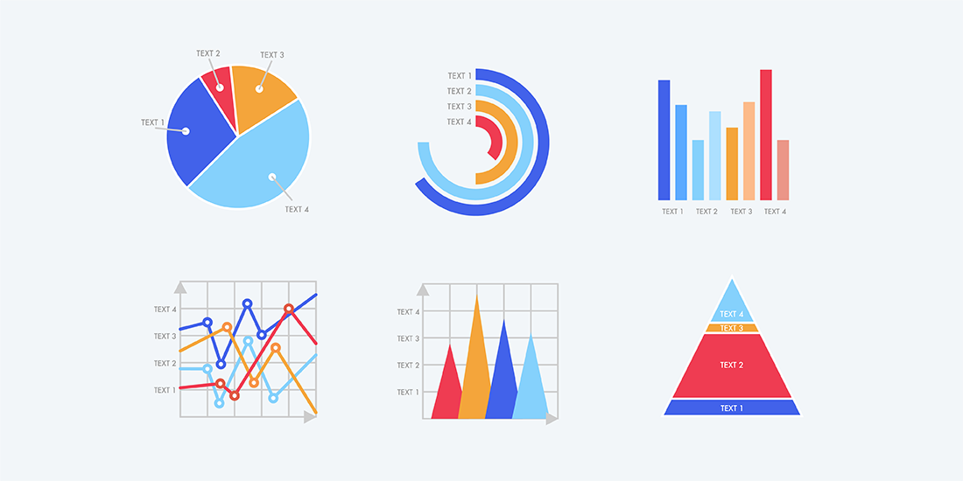
Analogy: Bake a cake and Make a Report
After oven we still have works to do
Data Visualization

Slide 29
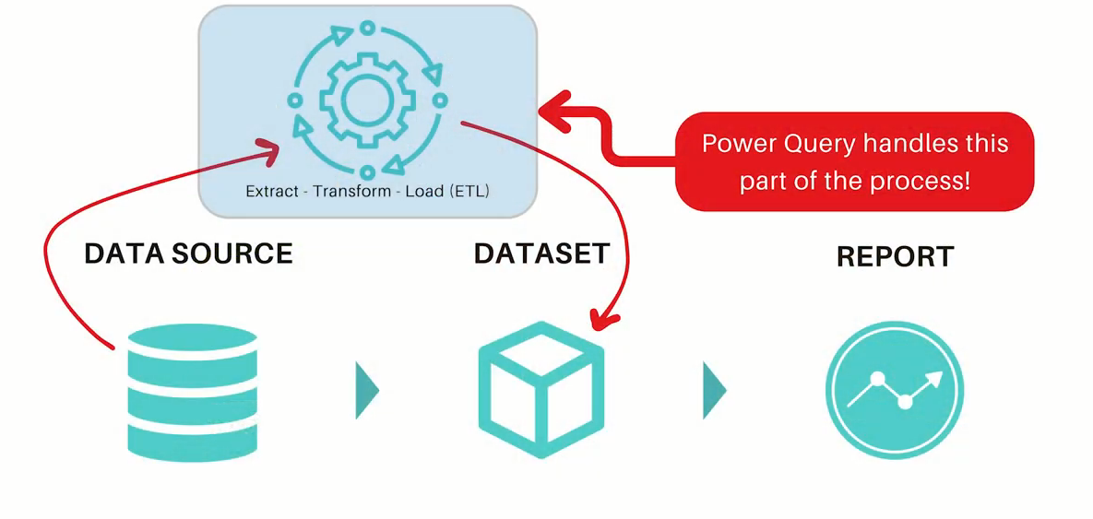

Analogy: Bake a cake and Make a Report
Power Query
Power Query
M
Language
You prepare gradients
in the Kitchen
You can find in: Excel , Power Bi ,
PowerApps , …etc.

Slide 30
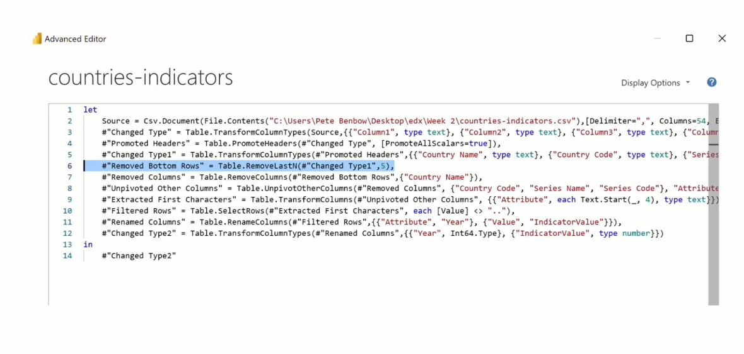
Power Query
Power Query M Language
(M Language )
The software behind is:
Power Query Mashup Engine

Slide 31
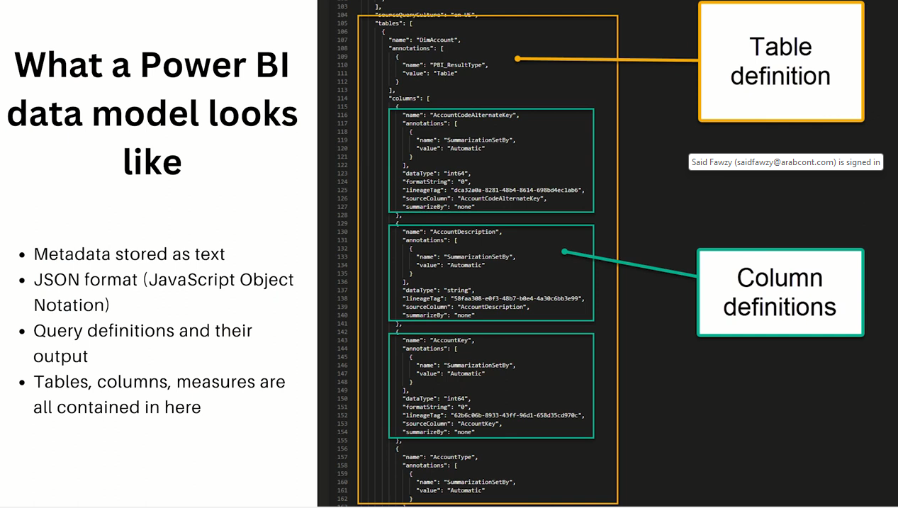
Data Model

Slide 32
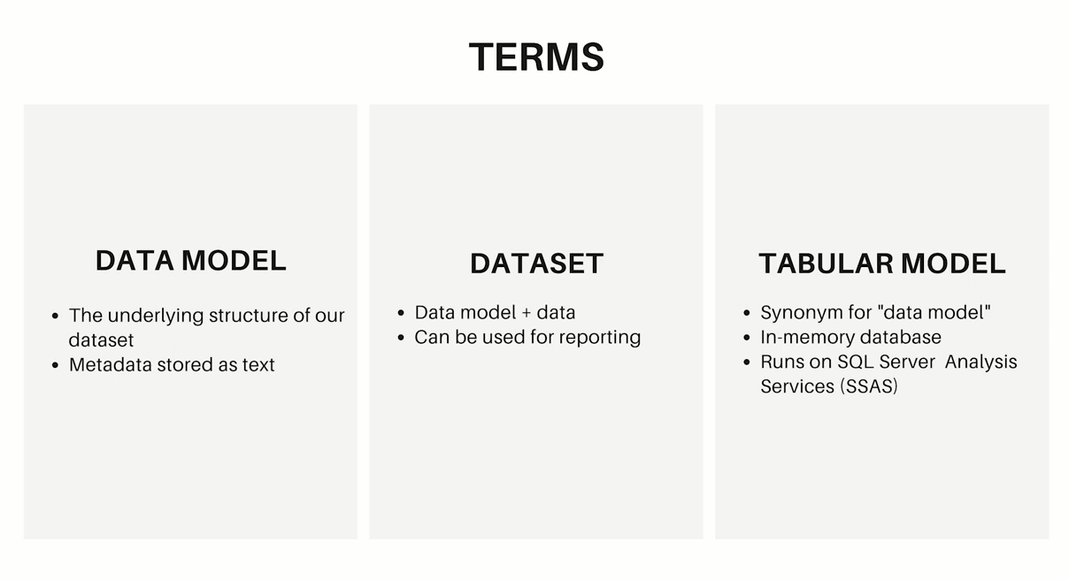

Slide 33
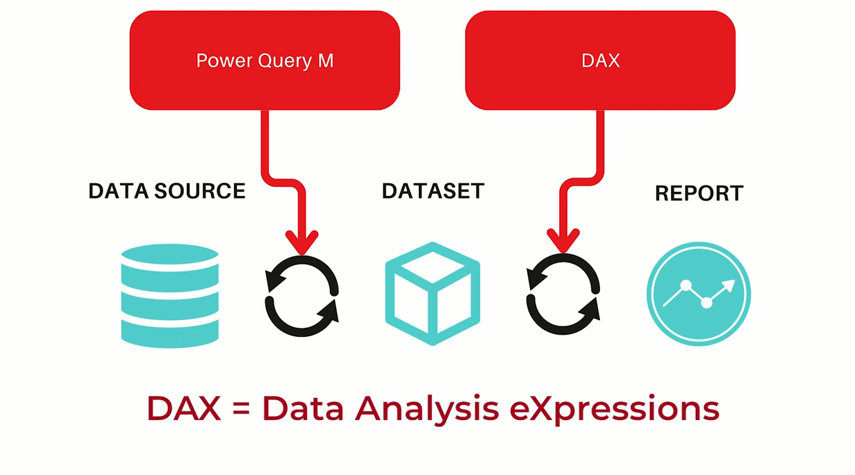
DAX

Slide 34
DAX
Dax Query

Slide 35
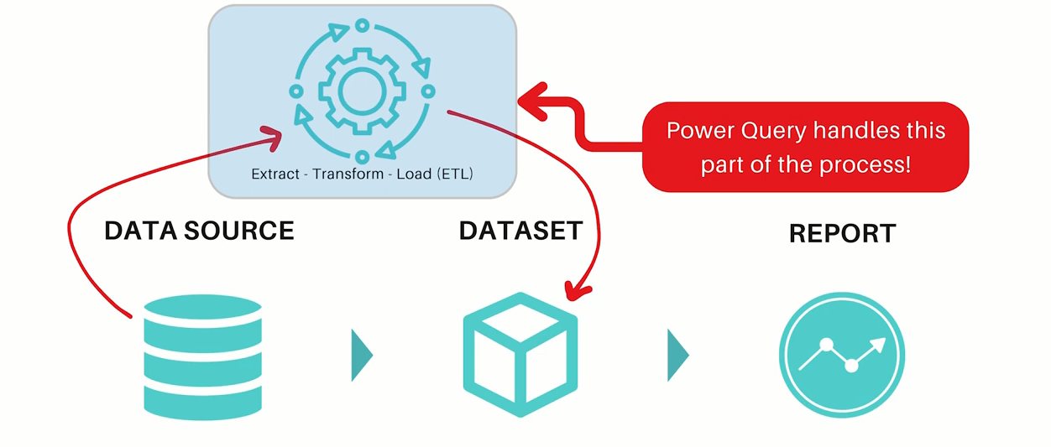
M vas DAX
M is used to extract , transform and load data
from data source to dataset

Slide 36
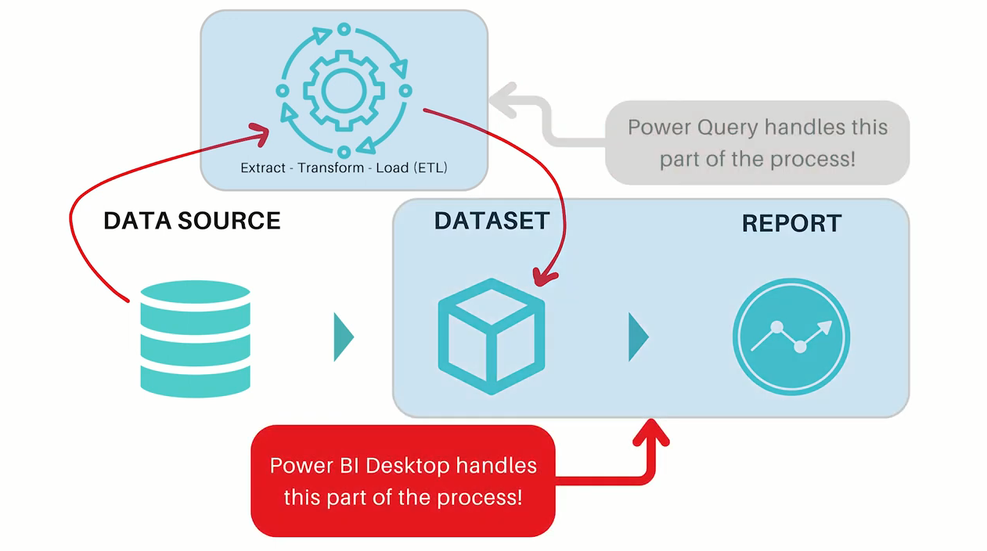
M vas DAX
Dax is used to communicate between the report
and dataset through measures and queries.

Slide 37
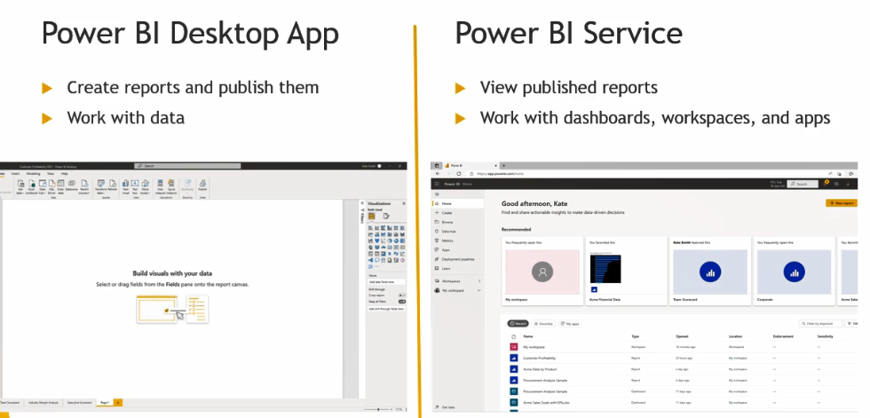
Walk Through Journey of Power BI

Slide 38
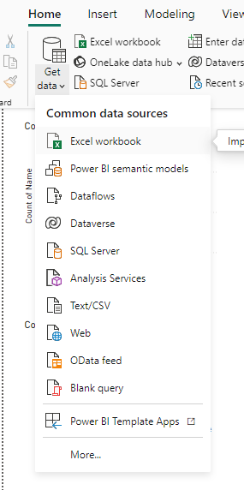
Walk Through Journey of Power BI
Getting Data

Slide 39
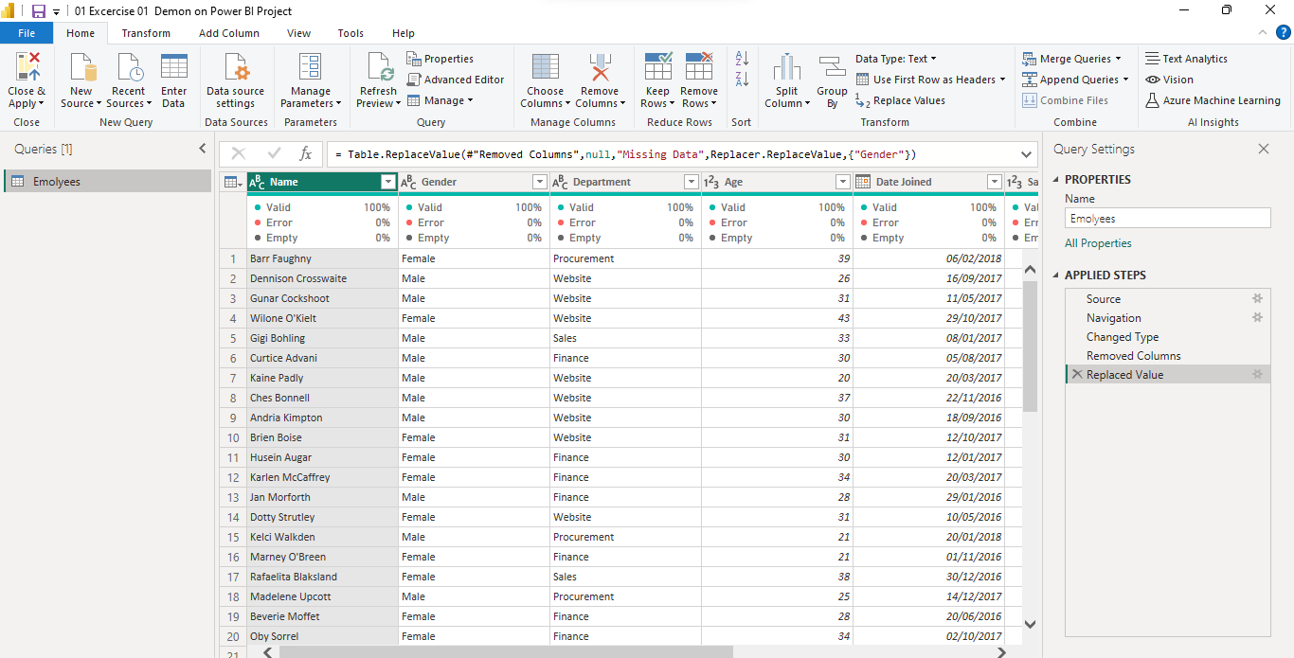
Walk Through Journey of Power BI
Power Query

Slide 40
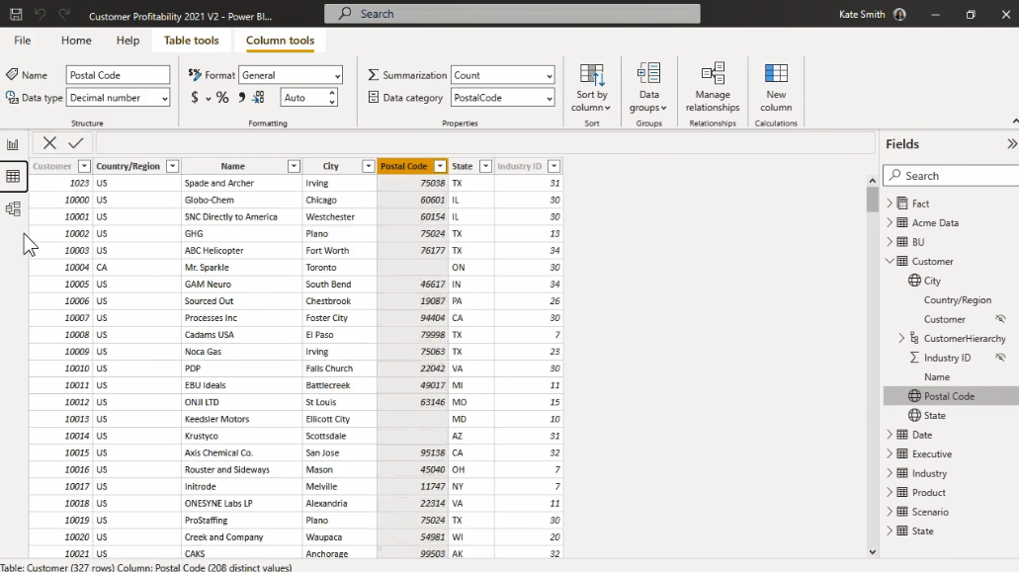
Walk Through Journey of Power BI
Table View

Slide 41
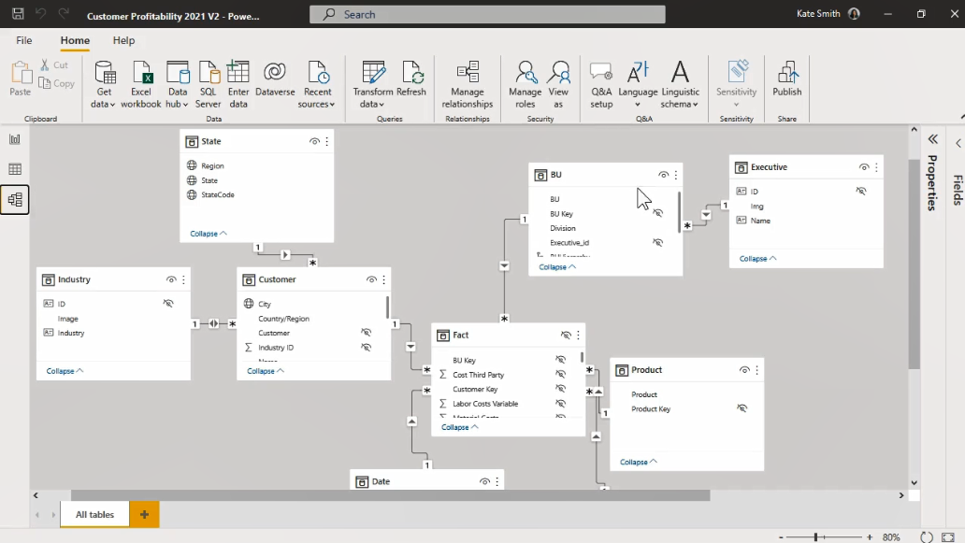
Walk Through Journey of Power BI
Model View

Slide 42
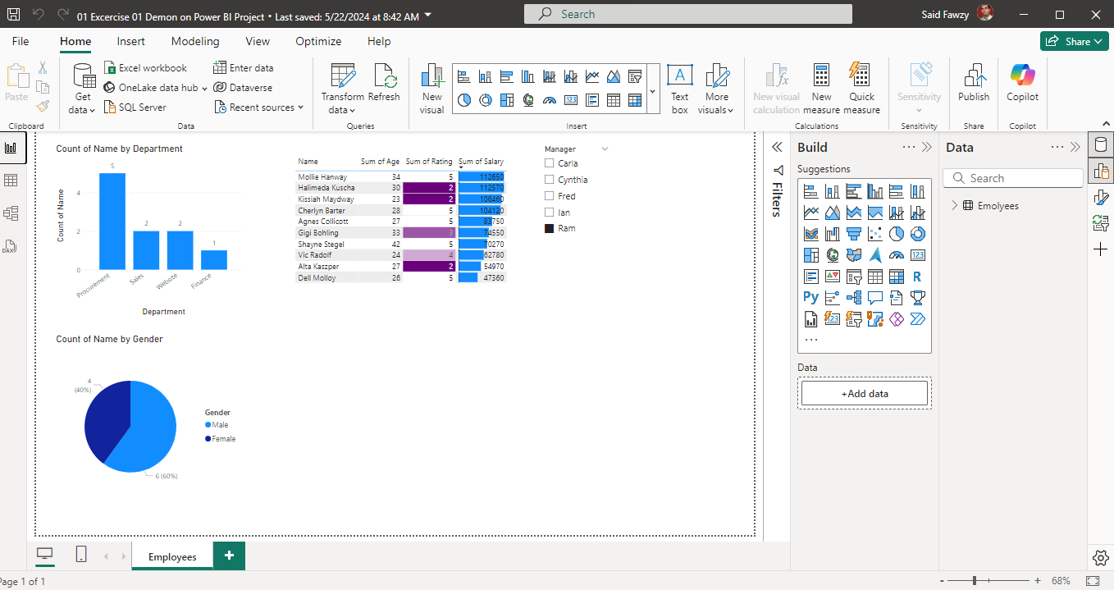
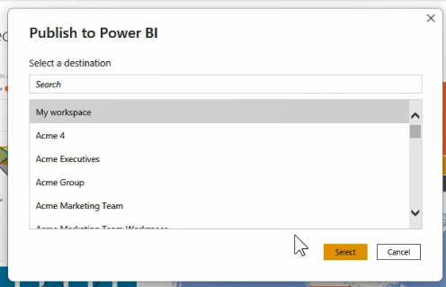
Walk Through Journey of Power BI
Report View

Slide 43
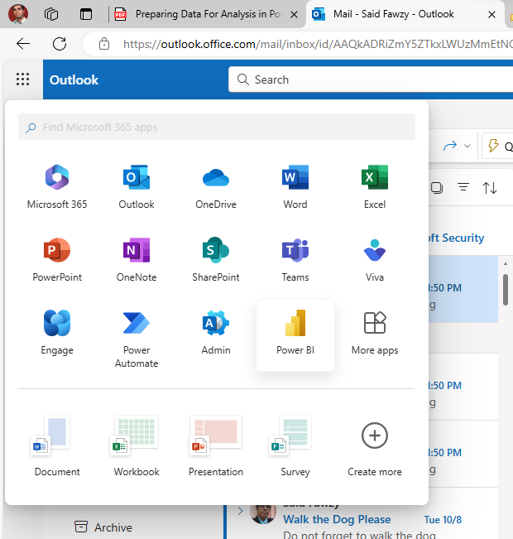
Walk Through Journey of Power BI
Power BI Service

Slide 44
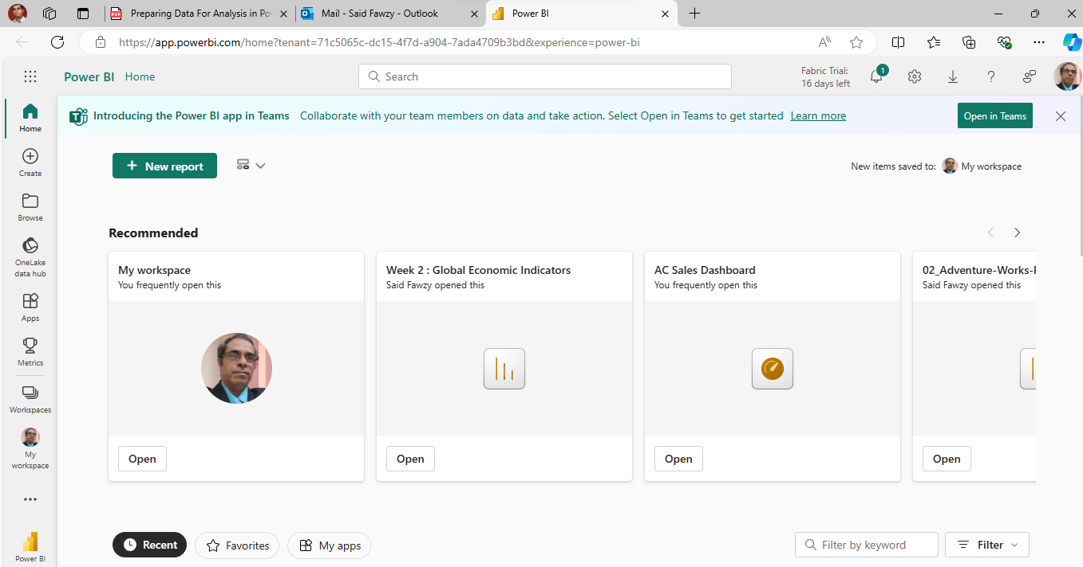

Walk Through Journey of Power BI

Slide 45
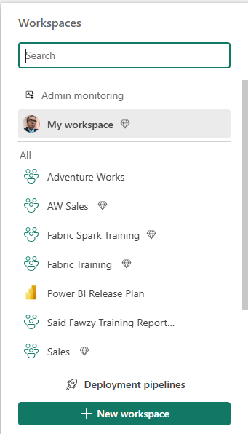
Walk Through Journey of Power BI
My Workspace is private

Slide 46
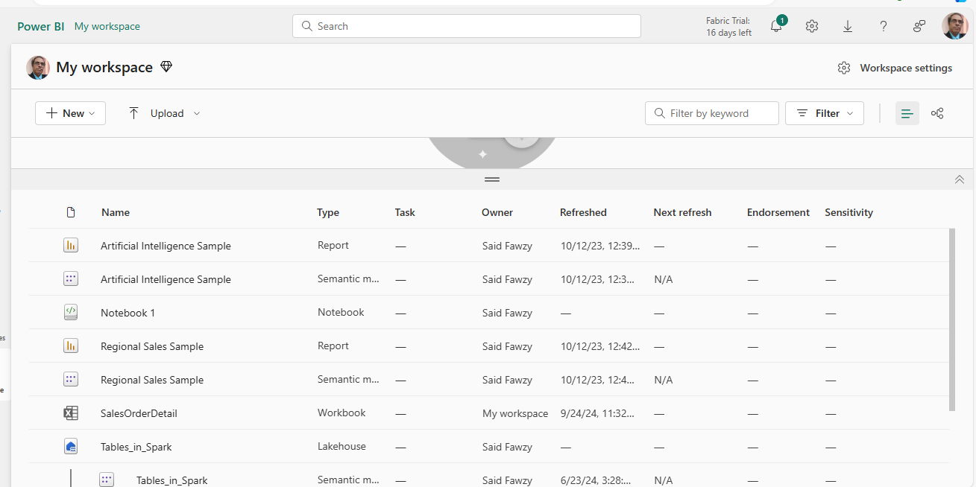
Walk Through Journey of Power BI

Slide 47
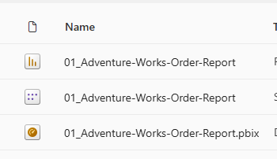
Walk Through Journey of Power BI
Report
Symantec Model
Dashboard

Slide 48
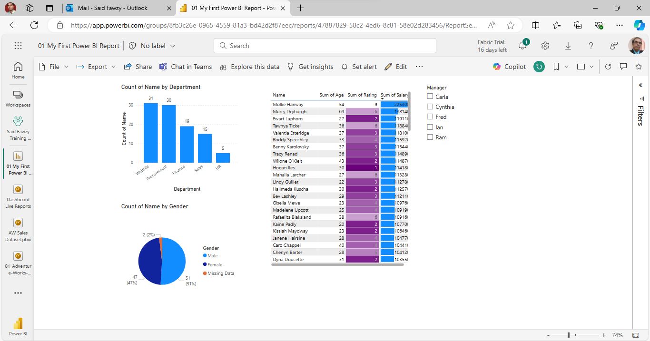
Walk Through Journey of Power BI
Published Report

Slide 49

Walk Through Journey of Power BI
Dashboard

Slide 50

Walk Through Journey of Power BI
Apps

Slide 51

Demo 1
Walkthrough Power BI Journey

Slide 52

Power BI Licenses

Slide 53



Power BI Licenses
Free License

Slide 54







Power BI Licenses
Pro License

Slide 55

Power BI Licenses
Premium Per User (PPU) License

Slide 56


Check Your Power BI Licenses

Slide 57
Download Power BI Desktop
Option 1: Power BI Site
https://powerbi.microsoft.com/en-us/downloads/
Advantage: You can apply to many computers

Slide 58

Download Power BI Desktop
https://powerbi.microsoft.com/en-us/downloads/

Slide 59

Download Power BI Desktop

Slide 60

Download Power BI Desktop

Slide 61

Download Power BI Desktop
Option 2: Microsoft Store
Advantage: Software Updates Automatically

Slide 62

Download Power BI Desktop

Slide 63

Download Power BI Desktop

Slide 64

1

Slide 65


